Slide 1


WhatsApp Pay
WhatsApp PAY
CBAP – Project

Slide 2
Agenda
Present By
01
Introduction
WhatsApp pay
Stakeholders
02
Risk
identification
SWOT Analysis
M . Anand
Transition state
03
Business Requirement
Functional Requirement
Non Functional Requirement
04
Business Objectives
IN Scope and OUT of Scope
Business Objectives

Slide 3


Introduction
WhatsApp-pay
WhatsApp is a messaging and Voice over IP (VoIP) service owned by Facebook. It allows users to send text and voice messages, makes voice and video calls, and share images, documents, and other media. WhatsApp runs on mobile devices but is also accessible from desktop computers. WhatsApp has over 2 billion users worldwide as of today. It has become the primary means of electronic communication in multiple countries across multiple continents, including Latin America, the Indian subcontinent, and large parts of Europe and Africa.

Slide 4

Users do not need to download a separate app to access the payment feature.
WhatsApp Pay will be provided as an update to the existing WhatsApp messaging app.
The feature is expected to be launched in India and then globally after its launch in Brazil.
WhatsApp is banking on its popularity and large user base (2 billion users) to gain an advantage over other payment apps.
The company aims to disrupt the global digital payments ecosystem with this new feature."
The global mobile payments market is rapidly growing and expected to reach USD 12,407.5 billion by 2025, with a CAGR of 23.8%. WhatsApp, a leading mobile messaging app, aims to enter this market by offering mobile payment services through its platform.
"WhatsApp has launched a new feature called WhatsApp Pay in Brazil in June 2020.
The feature allows users to integrate their debit or credit cards and transfer money to their peers while chatting.

Slide 5

STAKEHOLDERS
Stakeholders are Essential Parties Whose needs and expectations must be Managed to ensure project success in Business Analysis

Slide 6
BANKS
Debit card
Provider (Bank)
Integrate their banking system with the WhatsApp Pay system.
Process and approve transactions made through the WhatsApp Pay system.
Allow their debit cards to be linked to the WhatsApp Pay system
Process and approve debit card transactions made through the WhatsApp Pay system.
`
USER
Credit card Provider
Send and receive money to/from contacts on WhatsApp.
Link their bank account or credit/debit card to the WhatsApp Pay system.
View their transaction history on the app.
Allow their credit cards to be linked to the WhatsApp Pay system
Process and approve credit card transactions made through the WhatsApp Pay system.

Slide 7
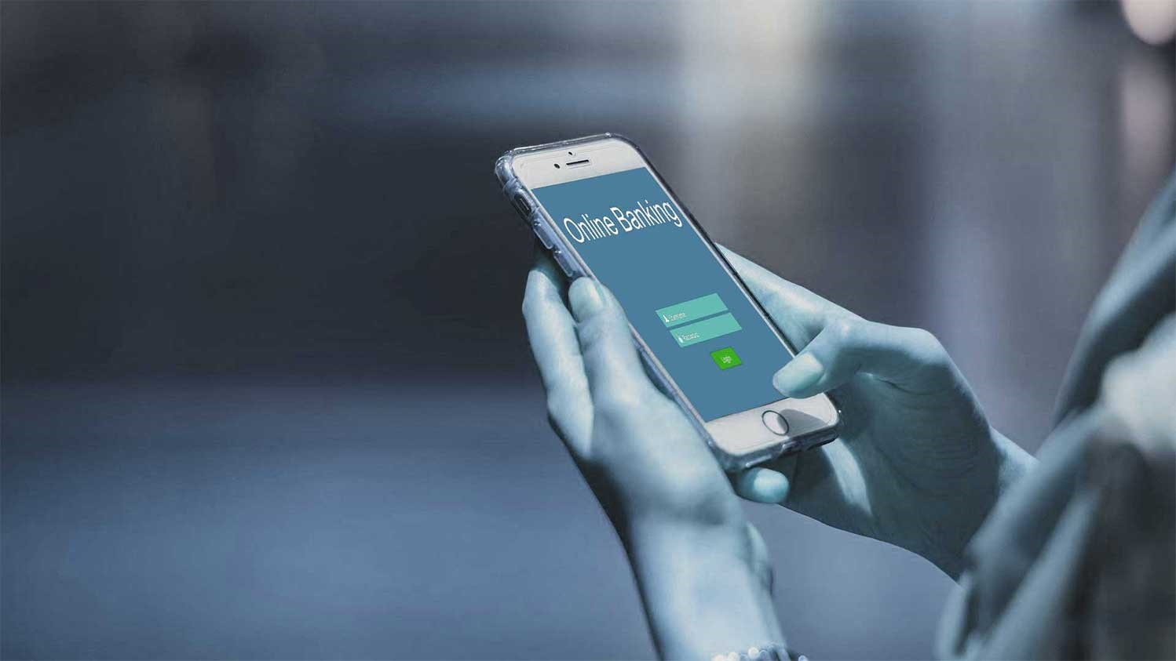
ID | Risk Description | Consequence | Trigger | Probability | Impact | Risk Level | Risk Owner
1 | Subject Matter Experts are not available during elicitation activities | Scope and quality shall be reduced, and delivery date may be pushed back | Elicitation | 40% | 5 | 2.0 | Bhalla
2 | Payment Option And Method Description | Two Method Has Shared by stakeholder (2 Method Have QR CODE )Which Has to Be user specific and it will take time | Development | 30% | 4 | 2.0 | Prasad
3 | Changes in Applications | Staff Availability is issue | Change implementation | 20% | 4 | 0.9 | Vamshi
4 | Constructed solution does not meet all the Business s | Realized Value May reduce | Validation | 30% | 3 | 0.6 | Chethan
5 | System And Technology | Arranged of New System and Technology Will be issue due to New changes | Elicitation | 20% | 3 | 0.7 | Prem
Risk Identification
Identify risks That may occur in this new System and process.

Slide 8
ID | Risk Description | Consequence | Trigger | Probability | Impact | Risk Level | Risk Owner
1 | Subject Matter Experts are not available during elicitation activities | Scope and quality shall be reduced, and delivery date may be pushed back | Elicitation | 40% | 5 | 2.0
2 | Payment Option And Method Description | Two Method Has Shared by stakeholder (2 Method Have QR CODE )Which Has to Be user specific and it will take time | Development | 30% | 4 | 2.0
3 | Changes in Applications | Staff Availability is issue | Change implementation | 20% | 4 | 0.9
4 | Constructed solution does not meet all the Business s | Realized Value May reduce | Validation | 30% | 3 | 0.6
5 | System And Technology | Arranged of New System and Technology Will be issue due to New changes | Elicitation | 20% | 3 | 0.7

Slide 9

SWOT
S
T
W
O
Analysis

Slide 10

Strengths:
User-friendly interface.
Secure and encrypted transactions.
Integrates with major banks and credit card providers.
Strengths
Threats:
Threats:
Competition from other digital payments platforms.
Regulatory restrictions.
Security breaches and data privacy concerns.
Opportunities:
Expansion to new markets.
Integration with more banks and credit card providers.
Potential for additional features like bill payments and peer-to-peer lending.
Opportunities:
Weaknesses:
Weaknesses
Limited availability in certain countries due to regulatory restrictions.
Limited number of partner banks and credit card providers.
Dependency on network connectivity for transactions.

Slide 11

Identify The Transition State
of WhatsApp
PAY NOW
The proposed system is a digital payments platform within the WhatsApp app. Users can link their bank account or credit/debit card to the system and send/receive money to/from contacts on WhatsApp.

Slide 12
PURPOSEDSYSTEM
PAY NOW
The proposed system is a digital payments platform within the WhatsApp app. Users can link their bank account or credit/debit card to the system and send/receive money to/from contacts on WhatsApp.

Slide 13
User –Friendly Interface
Integrated with WhatsApp
Secure and Reliable
Multi –Currency Support
PAY NOW
Fast and convenient

Slide 14

Business Requirement :
Some Possible Business Requirement For WhatsApp Pay.
Integration with Banks
Compliance
User-Friendly Interface
Transaction Limits
Payment Notifications
Security
Customer Support:

Slide 15
Integration with Banks: WhatsApp Pay needs to integrate with banks to enable users to link their bank accounts to their WhatsApp Pay account
Compliance: WhatsApp Pay needs to comply with relevant regulations and standards, such as KYC (Know Your Customer) and anti-money laundering (AML) regulations.
User-Friendly Interface: WhatsApp Pay needs to provide a simple and intuitive user interface that makes it easy for users to initiate transactions and view their transaction history
Transaction Limits: WhatsApp Pay needs to implement transaction limits to prevent fraud and ensure the security of user funds
Business Requirement :
Payment Notifications: WhatsApp Pay needs to provide users with notifications for every payment they receive or make, to keep them informed about their transactions
Security: WhatsApp Pay needs to ensure the security of transactions and user data by implementing strong encryption and other security measures
Customer Support: WhatsApp Pay needs to provide customer support for users who encounter issues with the service, such as failed transactions or incorrect payments
Some Possible Business Requirement For WhatsApp Pay.
Integration with Banks
Compliance
User-Friendly Interface
Transaction Limits
Payment Notifications
Security
Customer Support:

Slide 16
Integration with Banks: WhatsApp Pay needs to integrate with banks to enable users to link their bank accounts to their WhatsApp Pay account
Compliance: WhatsApp Pay needs to comply with relevant regulations and standards, such as KYC (Know Your Customer) and anti-money laundering (AML) regulations.
User-Friendly Interface: WhatsApp Pay needs to provide a simple and intuitive user interface that makes it easy for users to initiate transactions and view their transaction history
Transaction Limits: WhatsApp Pay needs to implement transaction limits to prevent fraud and ensure the security of user funds
Payment Notifications: WhatsApp Pay needs to provide users with notifications for every payment they receive or make, to keep them informed about their transactions
Security: WhatsApp Pay needs to ensure the security of transactions and user data by implementing strong encryption and other security measures
Customer Support: WhatsApp Pay needs to provide customer support for users who encounter issues with the service, such as failed transactions or incorrect payments
Business Requirement :
Some Possible Business Requirement For WhatsApp Pay.
Integration with Banks
Compliance
User-Friendly Interface
Transaction Limits
Payment Notifications
Security
Customer Support:

Slide 17
Functional Requirements
User registration and verification: Users need to be able to register for the service and verify their identity to ensure security and compliance with regulations.
Adding bank accounts: Users need to be able to link their bank accounts to their WhatsApp Pay account to enable transactions.
Initiating transactions: Users need to be able to initiate transactions with their contacts through the WhatsApp Pay interface.i
Viewing transaction history: Users need to be able to view their transaction history, including transaction details and status.
Receipt generation: WhatsApp Pay needs to generate receipts for every transaction to enable tracking and record-keeping.

Slide 18
Non- Functional Requirements
User registration and verification: Users need to be able to register for the service and verify their identity to ensure security and compliance with regulations.
Adding bank accounts: Users need to be able to link their bank accounts to their WhatsApp Pay account to enable transactions.
Initiating transactions: Users need to be able to initiate transactions with their contacts through the WhatsApp Pay interface.i
Viewing transaction history: Users need to be able to view their transaction history, including transaction details and status.
Receipt generation: WhatsApp Pay needs to generate receipts for every transaction to enable tracking and record-keeping.

Slide 19
Security and privacy: WhatsApp Pay needs to ensure the security and privacy of user data and transactions by implementing strong encryption and other security measures.
Reliability and availability: WhatsApp Pay needs to be highly reliable and available to ensure that transactions can be completed without interruption.
Scalability: WhatsApp Pay needs to be able to handle a large number of users and transactions as the service grows over time.
Usability: WhatsApp Pay needs to provide a simple and intuitive user interface that is easy to use and understand for users with varying levels of technical expertise.
Non- Functional Requirements

Slide 20
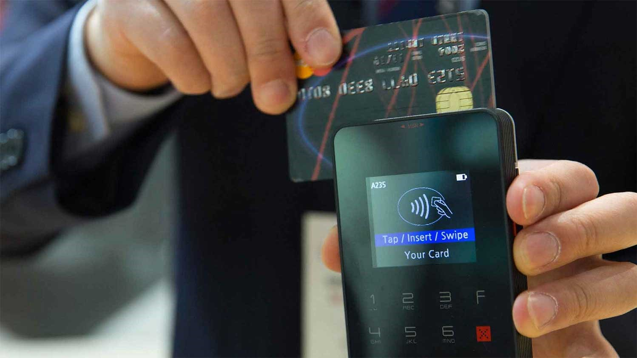
Business
Objectives
01
02
03
provide a secure and convenient digital payment service to WhatsApp users.
increase user engagement and retention.
easy and efficient way for users to transfer funds directly from their WhatsApp account.
04
05
the overall user experience of the platform and increase user loyalty.
build trust with its users and attract new users to the platform by offering a secure payment system

Slide 21

IN Scope items in this New Feature
IN Scope
Adding bank accounts: Users should be able to link their bank accounts to their WhatsApp Pay account in order to initiate transactions.
Initiating transactions: Users should be able to send and receive money to/from their contacts using their linked bank accounts.
Viewing transaction history: Users should be able to view their transaction history, including details such as the amount, date, and recipient.
Out of Scope items in this New Feature
Out of Scope
Credit score checks: WhatsApp Pay does not involve credit checks as it is a peer-to-peer payment service that only involves the transfer of funds between users.
Merchant transactions: WhatsApp Pay is primarily designed for peer-to-peer transactions and does not currently support merchant transactions.
Loan applications: WhatsApp Pay does not offer loan services or allow users to apply for loans

Slide 22
As-is and future process maps
(using flowcharts)

Slide 23
WhatsApp Login Page
Select User
Send Message to User
Start
As in Process Maps
WhatsApp Call or Chat
Message Has been Sent
END
Video Call or Voice call
Video Call Has been Done
Voice Call has been done

Slide 24
Future Process Maps
Select person from Contact List
WhatsApp Login Page
Select User
Send Message to User
Select Payment Option From WhatsApp Chat
Link Bank Account
Credit /Debit Card
Payment Option is Set
Enter Amount Wish to Transfer
Receiver Receive Payment Request
Enter Secure Pin
Yes
Payment Has to done or Not?
Click On Transfer Button
Decline
No
Payment Done
Payment Notifications will sent to both sender and receiver

Slide 25
Scope of the system Using USE Case Diagram (UML)
Whatsapp Login
Admin
Send Money To Contact Person
System Maintenance
Send Message to Both Receiver and sender
Whatsapp Message
Video Call
Customer
Login
Voice Call
Transaction
Notification Receive
Money Receive
Money Send

